Slide 1
Descriptive statistics

Slide 2
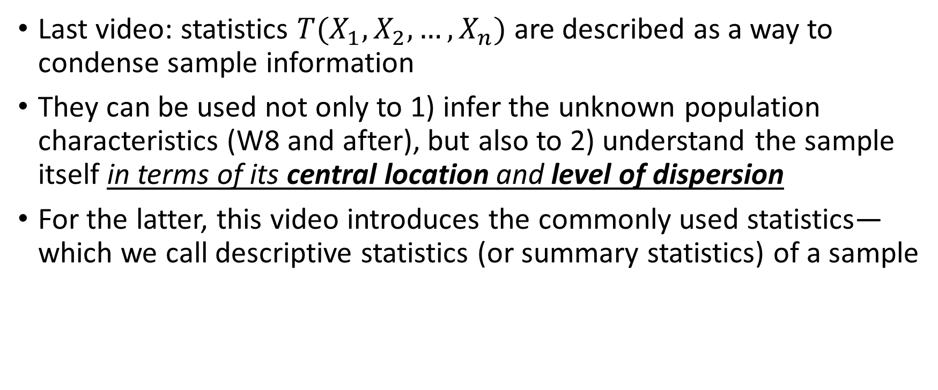
The dual role of statistics
Last video: statistics $T(X_{1},X_{2},…,X_{n})$ are described as a way to condense sample information
They can be used not only to 1) infer the unknown population characteristics (W8 and after), but also to 2) understand the sample itself in terms of its central location and level of dispersion
For the latter, this video introduces the commonly used statistics—which we call descriptive statistics (or summary statistics) of a sample

Slide 3
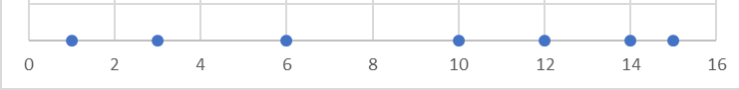
Common sample statistics
Measure of central location: Sample mean, Sample median
Measure of dispersions: Sample variance (standard deviations), Sample range (=max-min), & Interquartile range
Sample= [1,3,6,10,12,14,15]

Slide 4
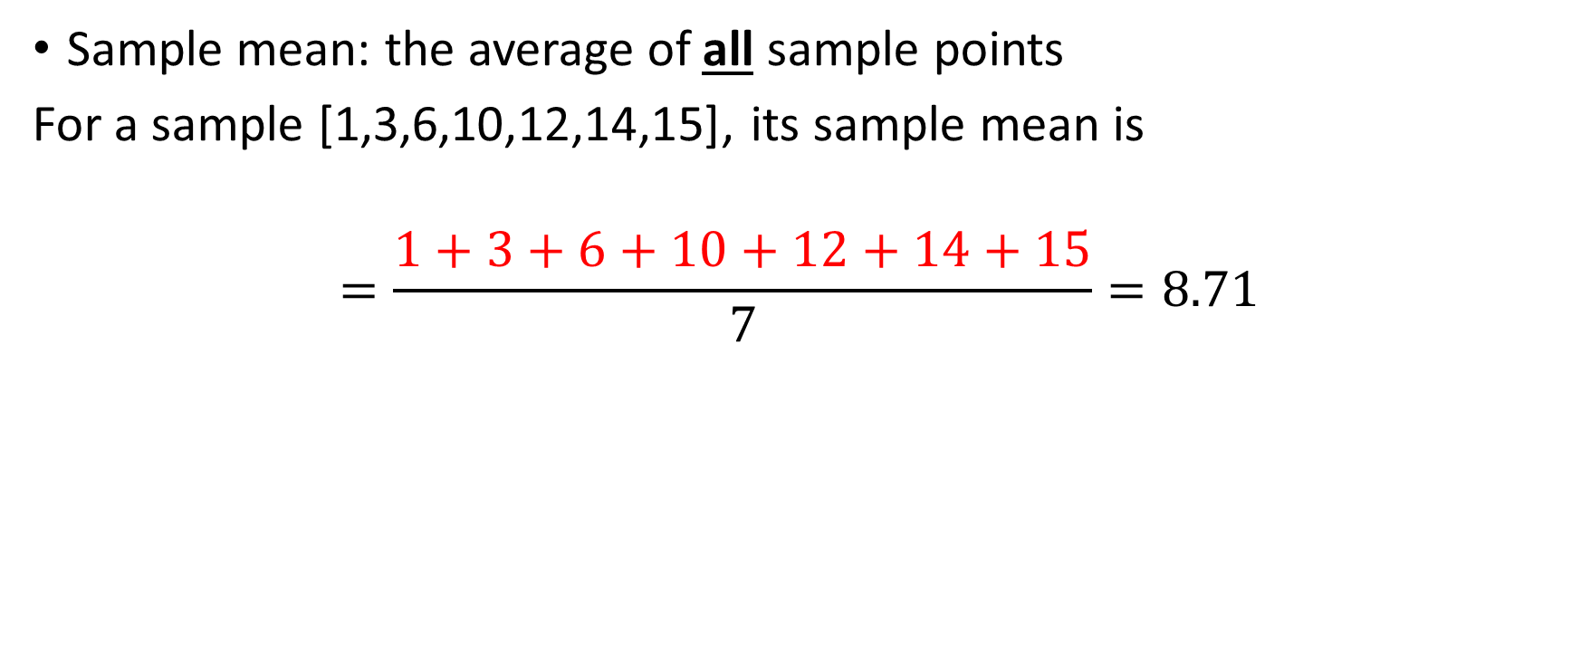
Sample mean vs. sample median
Sample mean: the average of all sample points
For a sample [1,3,6,10,12,14,15], its sample mean is
$$=\frac{1+3+6+10+12+14+15}{7}=8.71$$
When using sample mean as a measure of central tendency, we implicitly define the central tendency based on the values of all sample points

Slide 5

Sample mean vs. sample median
Sample median = the middle sample point (only)
For a sample [1,3,6,10,12,14,15], its sample median is the sample point right in the middle$=10$
FYI only: when sample size is even, sample median will be some average of the two sample points in the middle
When using sample median as a measure of central tendency, we implicitly define the central tendency based on the middle value of all sample points

Slide 6
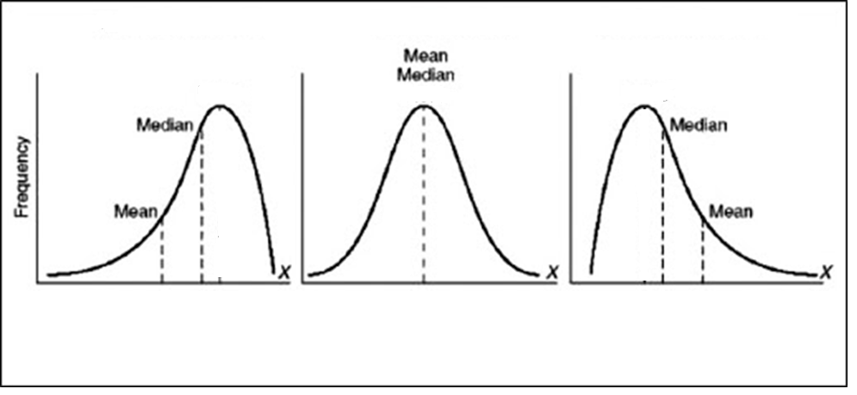
Left-skewed distribution
Symmetric distribution
Right-skewed distribution
e.g., [2,3,8,9,10]
Mean (6.4) < Median (8)
e.g., [6,7,8,9,10]
Mean (8)=Median (8)
e.g., [6,7,8,12,14]
Mean (9.4) > Median (8)
Sample mean is much more sensitive to “outliers” so better to use it in conjunction with “max” or “min”
But sample means have much nicer statistical tractability; so it’s more often used

Slide 7


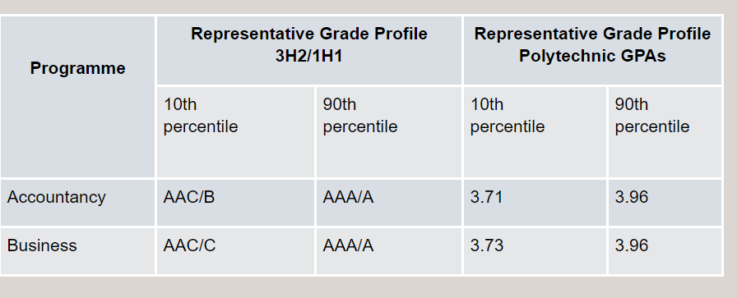
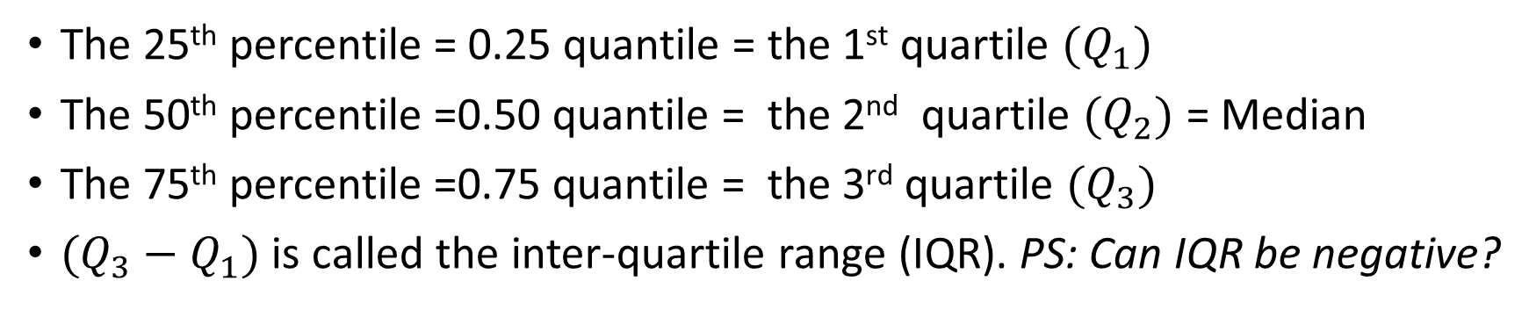
The percentile function
GPA
Lowest
Highest
0
100
percentile
0
1.0
quantile
0
1st
2nd
3rd
quartile
The 25th percentile = 0.25 quantile = the 1st quartile ${(Q}_{1})$
The 50th percentile =0.50 quantile = the 2nd quartile $(Q_{2})$ = Median
The 75th percentile =0.75 quantile = the 3rd quartile $(Q_{3})$
$(Q_{3}−Q_{1})$ is called the inter-quartile range (IQR). PS: Can IQR be negative?

Slide 8

Don’t forget these are still “statistics”!
All the statistics introduced here are statistics…so each has its own sampling distribution
$⇒$ This means that for different samples, you can get different values for them

Slide 9
R-applications Calculating descriptive statistics

Slide 10
Example: ChickWeight data
>help(ChickWeight) # or ?ChickWeight—get descriptions of the data
>View(ChickWeight) # spreadsheet view of the data
>hist(ChickWeight$weight)
>mean(ChickWeight$weight)
>median(ChickWeight$weight)
>var(ChickWeight$weight)
>sd(ChickWeight$weight)
>range(ChickWeight$weight) # returns the minimum and maximum
>summary(ChickWeight$weight) #conveniently give you a summary table of many summary statistics

Slide 11
Example: Chick weight
>summary(ChickWeight$weight) #conveniently give you a summary table of quartiles, median, mean, etc
>quantile(ChickWeight$weight) # returns Q1 to Q4 of the sample
>quantile(ChickWeight$weight,p=0.5) # Q2=median
>quantile(ChickWeight$weight,p=0.25) # Q1
>quantile(ChickWeight$weight,p=0.75)-quantile(ChickWeight$weight,p=0.25) # the IQR; also can use IQR(ChickWeight$weight) directly

Slide 12
Measure of association
When there are more than one RV’s
Measure of association: Sample correlation coefficient
For example, to calculate the (sample) correlation coefficient between “weight” and “Time”
>cor(ChickWeight[,c("weight","Time")]) #ChickWeight[,c("weight","Time")] form a new dataframe with these two columns
#unfortunately, you couldn’t use cor(ChickWeight) to get all pairwise correlation coefficients. The chick and diet are not numerical.

Slide 13
Measure of association
When there are more than one RV’s
Measure of association: Sample correlation coefficient
For example, to calculate the (sample) correlation coefficient between “weight” and “Time”
>cor(ChickWeight[,c("weight","Time")]) #ChickWeight[,c("weight","Time")] form a new dataframe with these two columns
#unfortunately, you couldn’t use cor(ChickWeight) to get all pairwise correlation coefficients. The chick and diet are not numerical.

Slide 14
R-application: Box-plot

Slide 15
R-application: Box-whisker plots
Visualisation of
Central location
Dispersion/spread
Outliers
Median

Slide 16

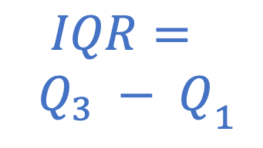

R-application: Box-whisker plots
Visualisation of
Central location
Dispersion/spread
Outliers
$$Q_{3}$$
${\begin{aligned}IQR= \\ Q_{3} − Q\end{aligned}}_{1}$
$$Q_{1}$$

Slide 17
R-application: Box-whisker plots
Outliers
Upper inner fence (UIF)
Visualisation of
Central location
Dispersion/spread
Outliers
Upper whisker
Lower whisker
Lower inner fence (LIF)

Slide 18
Example: Chick weight
>library(“datasets”) # Load the package for illustrative datasets
>chick<-ChickWeight # For detail, ?ChickWeight
>summary(chick$weight[chick$Diet ==2]) # Summary statistics
Min. 1st Qu. Median Mean 3rd Qu. Max.
39.0 65.5 104.5 122.6 163.0 331.0

Slide 19
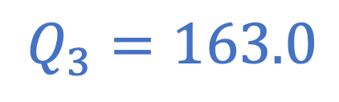
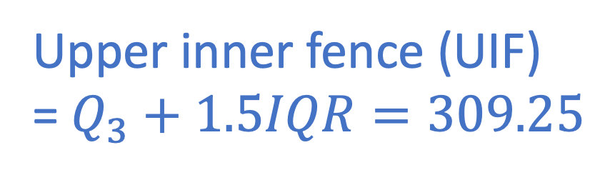
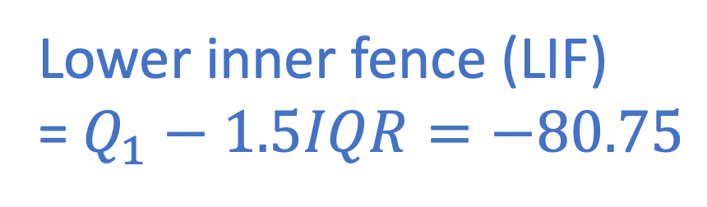

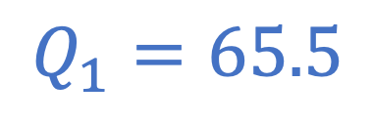
Min. 1st Qu. Median Mean 3rd Qu. Max.
39.0 65.5 104.5 122.6 163.0 331.0
Upper inner fence (UIF)
= $Q_{3}+1.5IQR=309.25$
$$Q_{3}=163.0$$
Median = 104.5
$IQR=$ 97.5
$$Q_{1}=65.5$$
Lower inner fence (LIF)
= $Q_{1}−1.5IQR=−80.75$

Slide 20
Min. 1st Qu. Median Mean 3rd Qu. Max.
39.0 65.5 104.5 122.6 163.0 331.0
Upper inner fence (UIF)
= $Q_{3}+1.5IQR=309.25$
Lower whisker = Min. = 39.0
Lower inner fence (LIF)
= $Q_{1}−1.5IQR=−80.75$

Slide 21
Example: Chick weight
>library(“datasets”) # Load the package for illustrative datasets
>chick<-ChickWeight # For detail, ?ChickWeight
>summary(chick$weight[chick$Diet ==2]) # Summary statistics
>tail(sort(chick$weight[chick$Diet ==2])) # Check largest 6 data values
275 279 307 309 318 331

Slide 22

Example: Chick weight
>library(“datasets”) # Load the package for illustrative datasets
>chick<-ChickWeight # For detail, ?ChickWeight
>summary(chick$weight[chick$Diet ==2]) # Summary statistics
>tail(sort(chick$weight[chick$Diet ==2])) # Check largest 6 data values
275 279 307 309 318 331
UIF$= 309.25$

Slide 23
Example: Chick weight
>library(“datasets”) # Load the package for illustrative datasets
>chick<-ChickWeight # For detail, ?ChickWeight
>summary(chick$weight[chick$Diet ==2]) # Summary statistics
>tail(sort(chick$weight[chick$Diet ==2])) # Check largest 6 data values
275 279 307 309 318 331
Outliers

Slide 24
Outliers
331
318
Upper whisker
= Largest data value within UIF
= 309

Slide 25

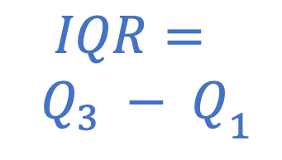
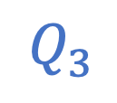
R-application: Box-whisker plots
Outliers
Upper whisker
= Largest data value within UIF
$$Q_{3}$$
Median
${\begin{aligned}IQR= \\ Q_{3} − Q\end{aligned}}_{1}$
$$Q_{1}$$
Lower whisker
= Smallest data value within LIF

Slide 26
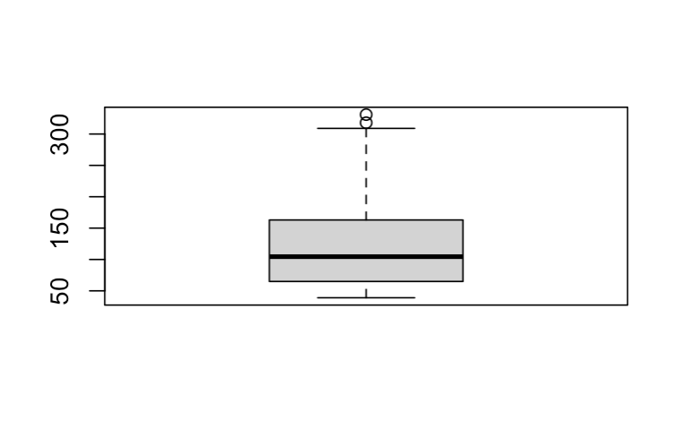
Example: Chick weight
>library(“datasets”) # Load the package for illustrative datasets
>chick<-ChickWeight # For detail, ?ChickWeight
>boxplot(chick$weight[chick$Diet == 2])

Slide 27
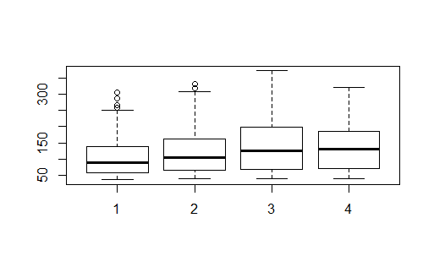
Example: Chick weight
>library(“datasets”) # Load the package for illustrative datasets
>chick<-ChickWeight # For detail, ?ChickWeight
>boxplot(chick$weight~chick$Diet) # Boxplot of weights by Diet groups
# “Y~X” for making the boxplot of Y according to the groups in X

